Slide 1
Approach to Classifying Batting Shots from Cricket Videos
1805009 - MD ZARZEES UDDIN SHAH CHOWDHURY
1805021 - ABDUS SAMEE

Slide 2
CricShotClassify: An Approach to Classifying Batting Shots from Cricket Videos Using a Convolutional Neural Network and Gated Recurrent Unit
Published in: Sensors
Publication year: 2021
Link: https://doi.org/10.3390/s21082846
Problem definition: Proposed a hybrid deep-neural-network architecture for classifying 10 different cricket batting shots from offline videos. They composed a novel dataset, CricShot10, comprising uneven lengths of batting shots and unpredictable illumination conditions.

Slide 3
Key Idea in the Paper
Developed the novel dataset CricShot10 consisting of 10 different cricket shots(cover drive, defensive shot, flick shot, hook, late cut, lofted shot, pull, square cut, straight drive, and sweep). This is the highest number of distinct cricket shots in a single work.
Designed a custom convolutional neural network (CNN)–recurrent neural network (RNN) architecture to classify the 10 different cricket shots.
Investigated the impact of different types of convolution on our dataset.
Investigated various transfer learning models to accurately classify batting shots.
Results: A hybrid CNN–GRU architecture, developed from a pretrained VGG16 model, achieved the highest accuracy of 93%

Slide 4
Code and Data availability
Dataset:
CricShot10 dataset - Google Drive
Code:
Not available. But contacted the owner and he gave us a tutorial to work with time distributed data.

Slide 5
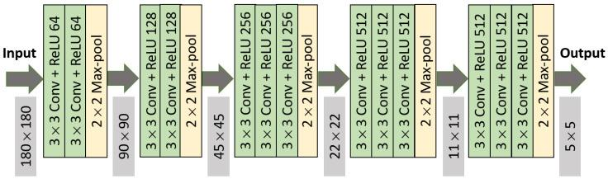
Model Designed

Slide 6
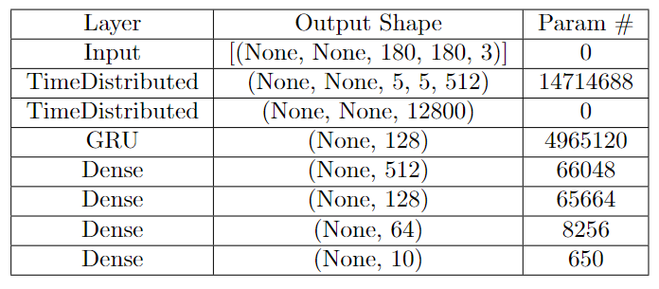
Model Designed - 1

Slide 7
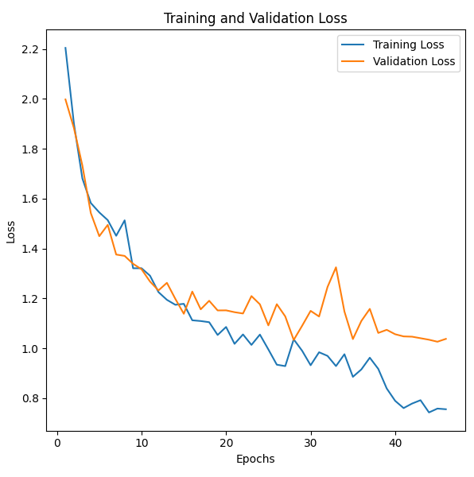
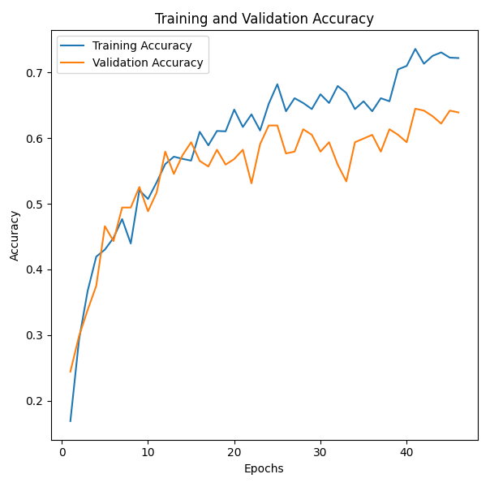
Experimental Results - 1

Slide 8
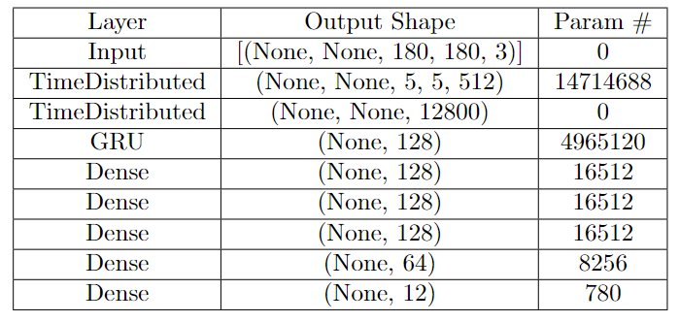
Model Designed - 2 (Reverse Sweep and Bowled Added)

Slide 9
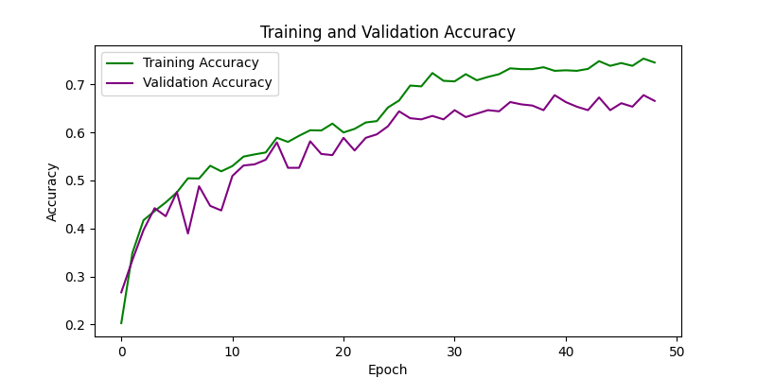
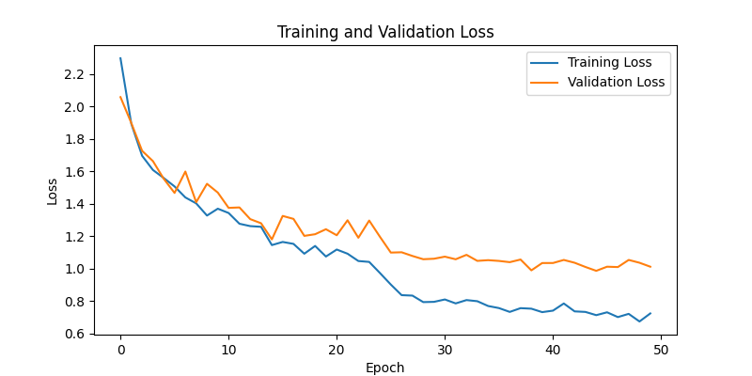
Experimental Results - 2

Slide 10
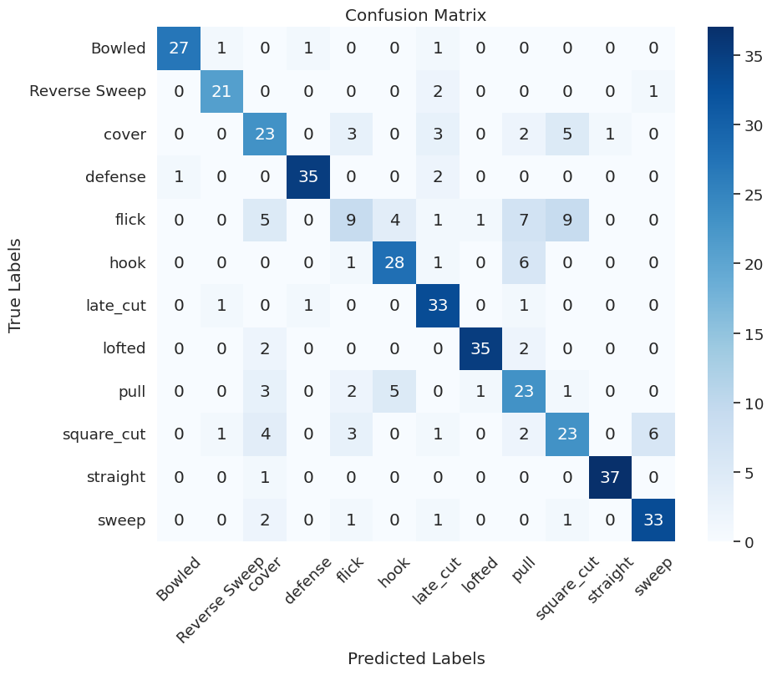

Slide 11
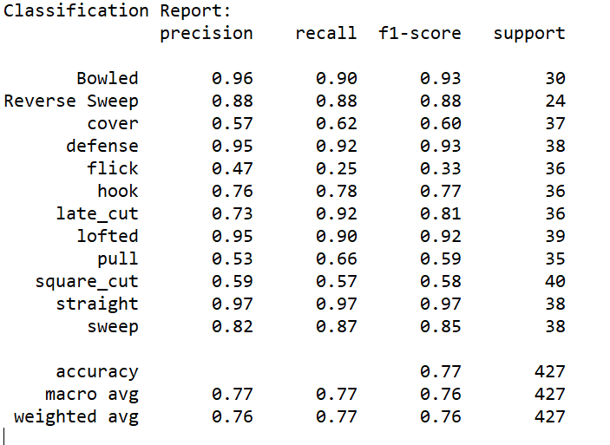

Slide 12
Demo

Slide 13
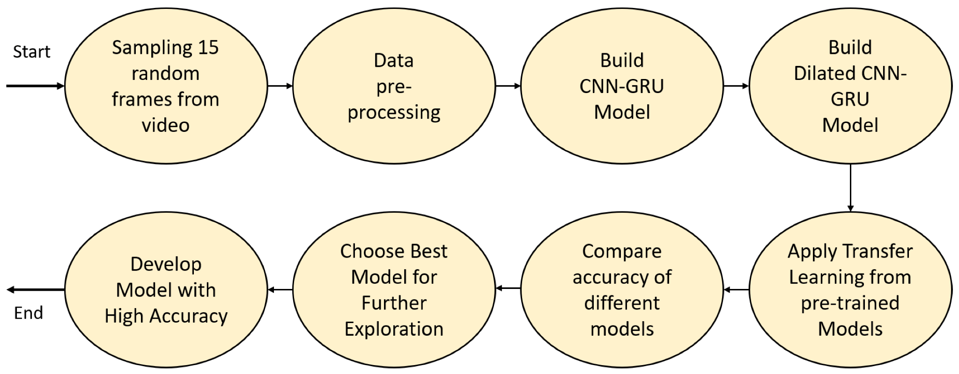
Key Idea in the Paper

Slide 14
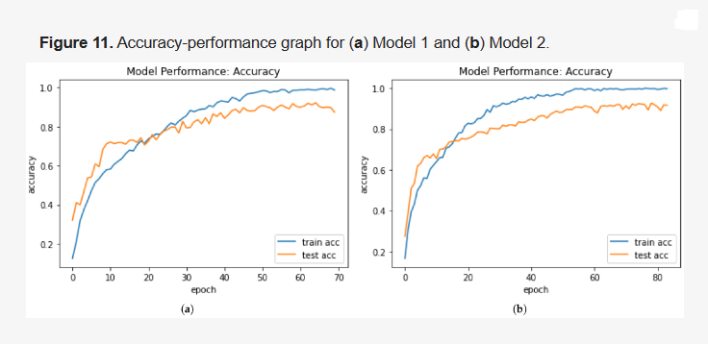
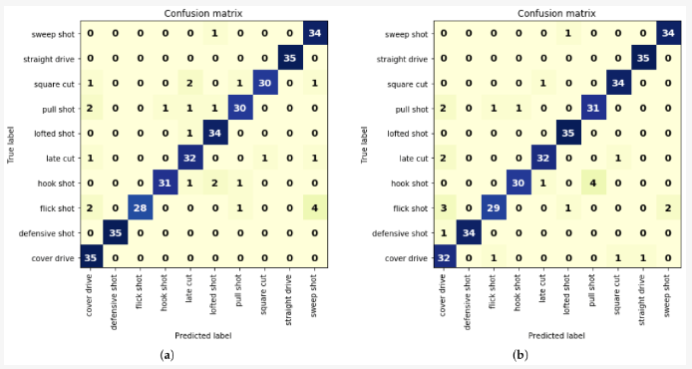
Proposed Experiment
Try to reproduce the performance metrics
Expand the dataset to include more shots e.g scoop, helicopter, reverse sweep, upper cut etc
Include different bowling like inswing,outswing, leg spin, off spin etc
Performance on CNN-GRU and DCNN-GRU models

